Slide 1
Sudoku
Dsa final project, Summer 2021
Muhammad aaliyan isrshad : mi05524
Mustafa Madraswala : mm05548
Sakina Shabbir : ss05562

Slide 2
Overview
By the end of the presentation we would have been able to demonstrate how the game works and how the 9x9 matrix board was created for our sudoku game.
Sudoku is a logic based puzzle game. It is board with 9x9 matrix. To win the player has to place a number in a way that the number is not repeated in the same column or row or 3x3 sub grid.
To win the game, all spaces on our board must be filled following the rules.

Slide 3
Algorithm used
In our code we used backtracking algorithm which will produce for us a unique sudoku board. Then the backtracking algorithm is used to solve the puzzle.
The player will enter values ranging from 1 to 9 but the value must not repeat in that row column or 3x3 matrix. He will then repeat this procedure until he comes to a point when no input is possible, at this point our code will backtrack. Then the player will have to return to his prior answer and make modifications. This backtracking continues until it finds the valid solution.
We use this method to verify all possible placements from the player as well as all combinations and to shorten the total duration while still producing a legitimate result.

Slide 4
Libraries and other resources used
The UI of our game will be implemented using pyGame.
The sudoku board is inatialized based on level selcted.

Slide 5
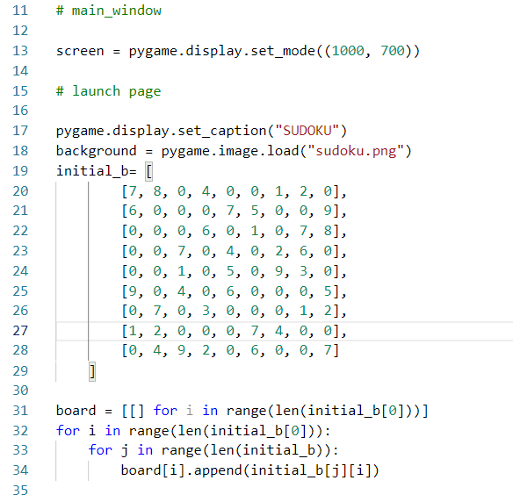
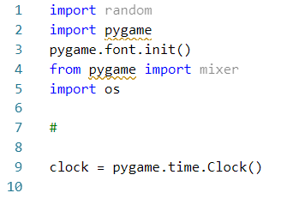
Main window and Launch page

Slide 6
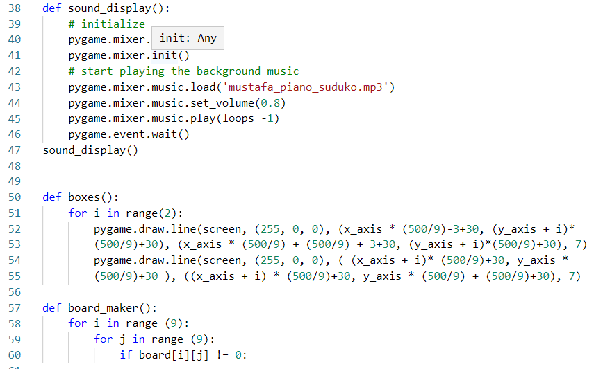
FUNCTIONS USED

Slide 7
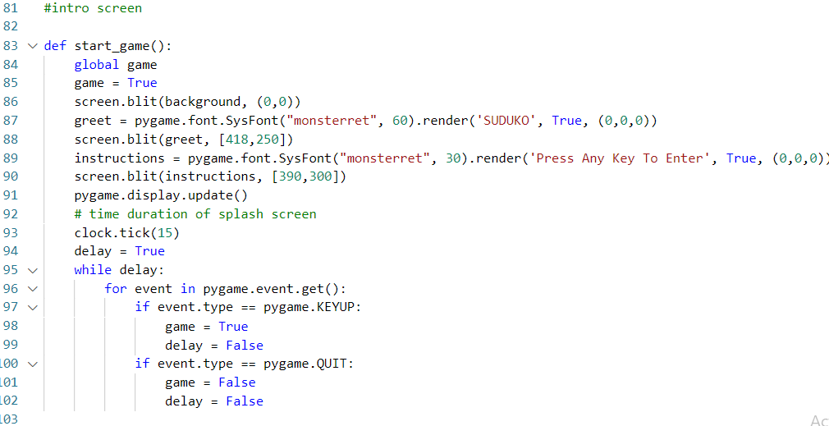
Intro screen

Slide 8
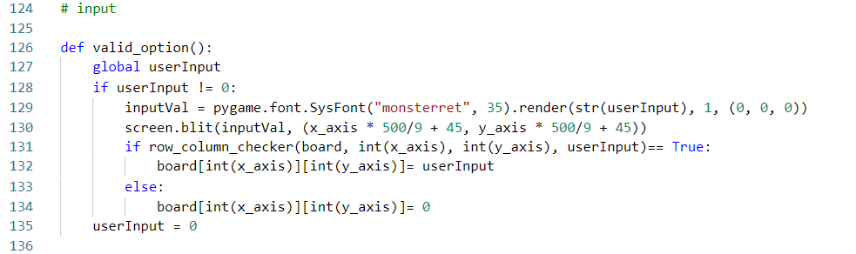
INPUT

Slide 9
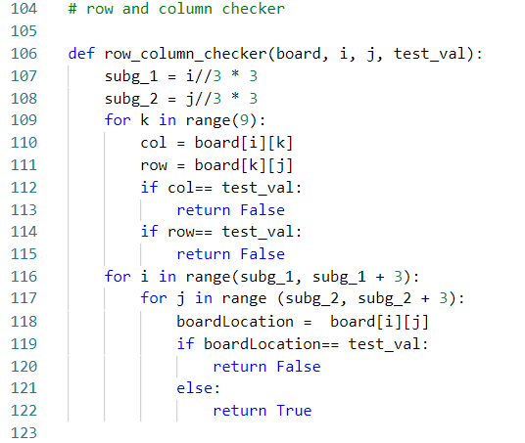
Row and column checker

Slide 10
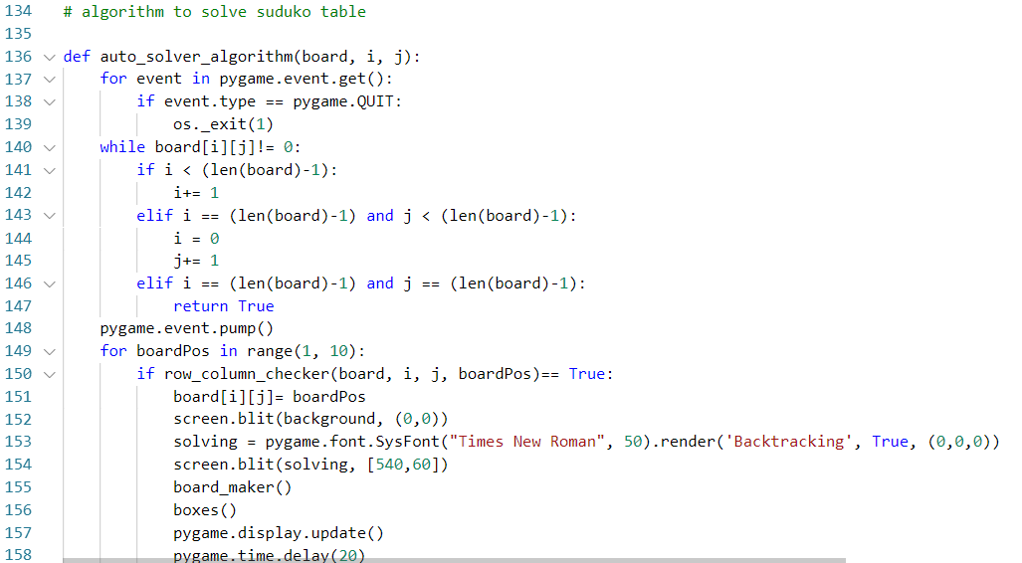
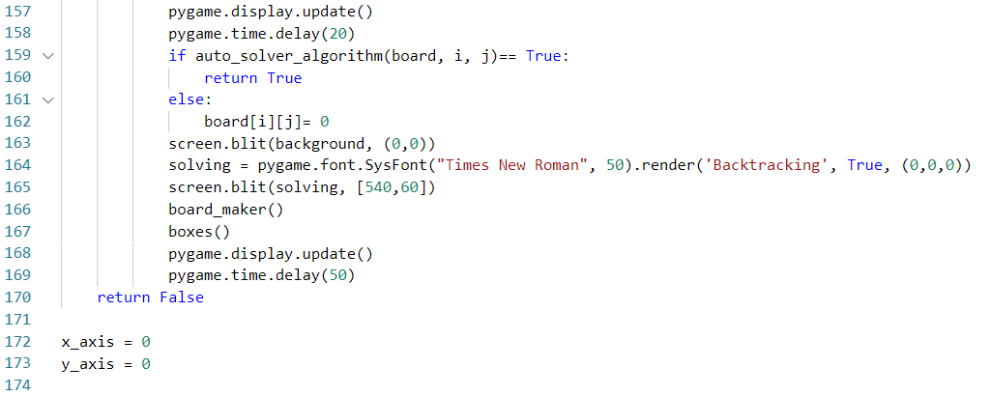
ALGORITHM TO SOLVE SUDOKU TABLE

Slide 11
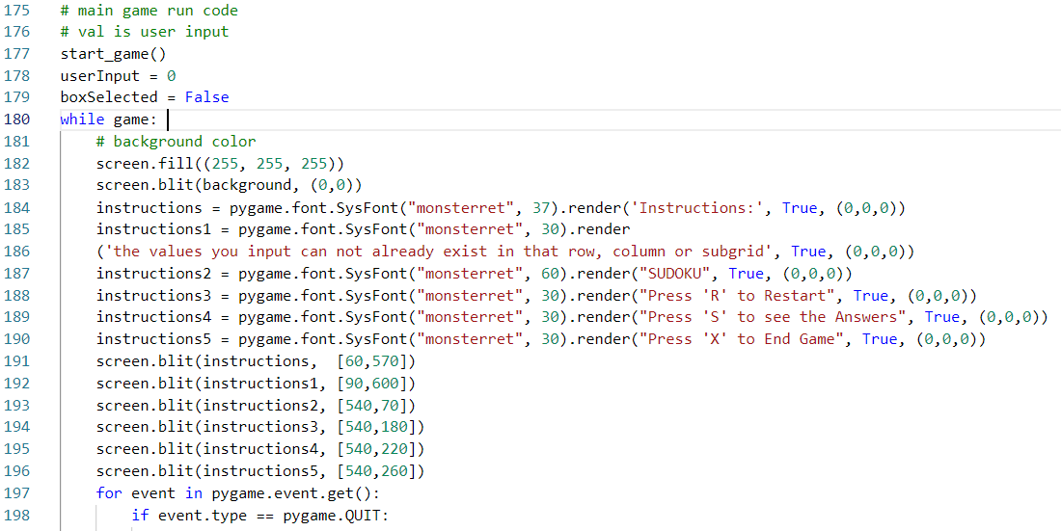
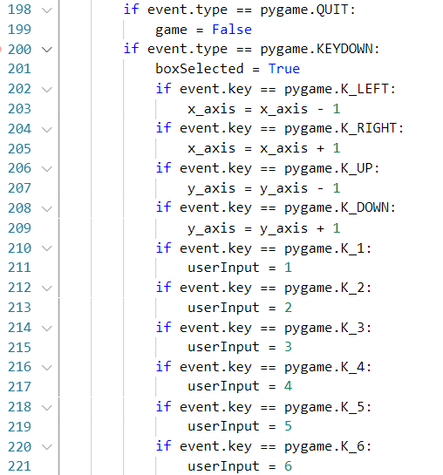
MAIN GAME RUN CODE

Slide 12
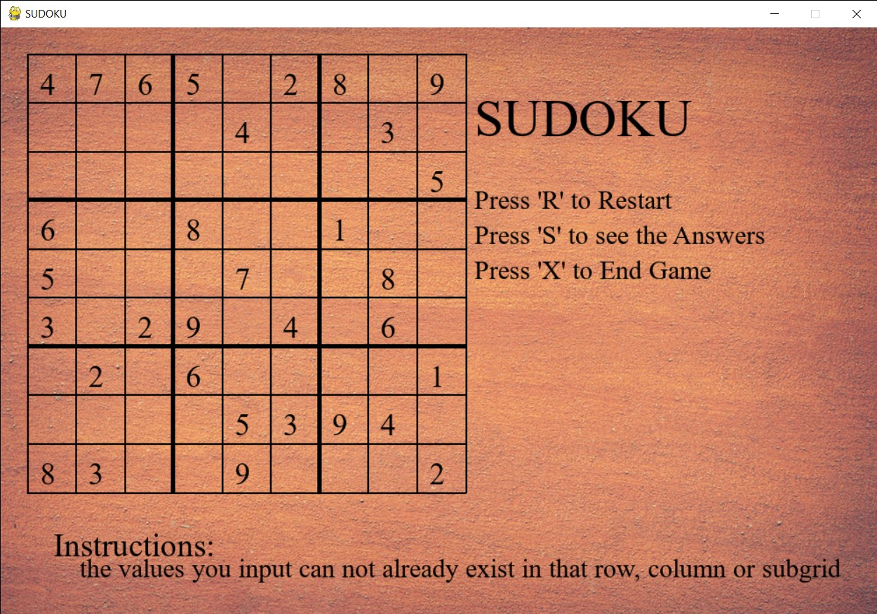
Output/main game display screen

Slide 13
Further improvements that can be done to our project.
We can make the game more visually better, we can add buttons that we can select using the mouse or touch if device has touch screen capabilities
We can add more movement to the screen an make it more interactive.
We can add an option to change the wallpaper screen or allow the game to choose its own random wallpaper every time new game is started.
We can also add an option that you can input your own sudoku table and let the software solve it for you.
Another thing I would like to add is that instead of the alortithim rewritting the values on the main table it can maybe add another table and solve the game side by side to your answers so you can visually see where you went wrong.

